Slide 1
Statistics with Spa ows
Lecture 9
Julia Schroeder

Slide 2
Outline
Linear models

Slide 3
Linear models
Most important concepts
Can model many questions (including previous t-test)
If you understand linear models, everything else will be easy as a breeze!
Aim to fit models to data

Slide 4
Fitting models to data

Slide 5
Fitting models to data
?

Slide 6
Fitting models to data

Slide 7
Fitting models to data

Slide 8
Fitting models to data

Slide 9
Fitting models to data

Slide 10
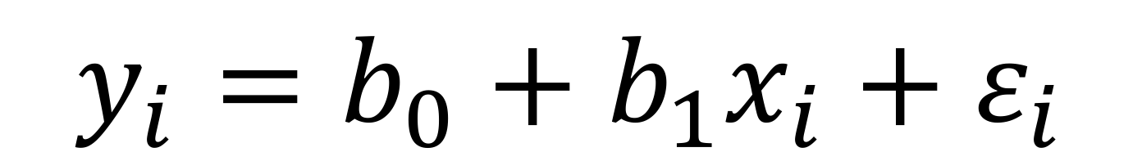
Linear models
$$y_{i}=b_{0}+b_{1}x_{i}+ε_{i}$$

Slide 11
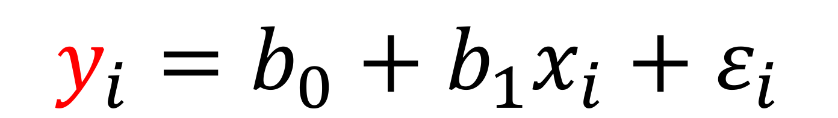
Linear models
$$y_{i}=b_{0}+b_{1}x_{i}+ε_{i}$$
y
5
3
6
10
4
Data. Response variable,
e.g. sparrow body mass.

Slide 12
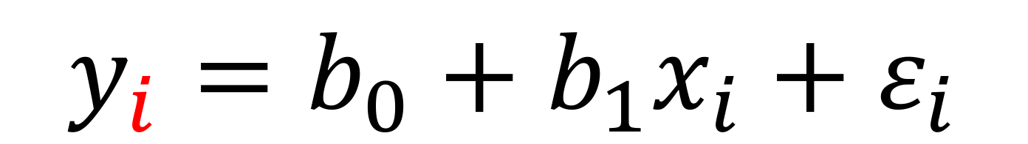
Linear models
$$y_{i}=b_{0}+b_{1}x_{i}+ε_{i}$$
y
5
3
6
10
4
i
1
2
3
4
5
Data. Response variable. Observation 1, 2, 3, etc.
e.g. sparrow body mass.

Slide 13
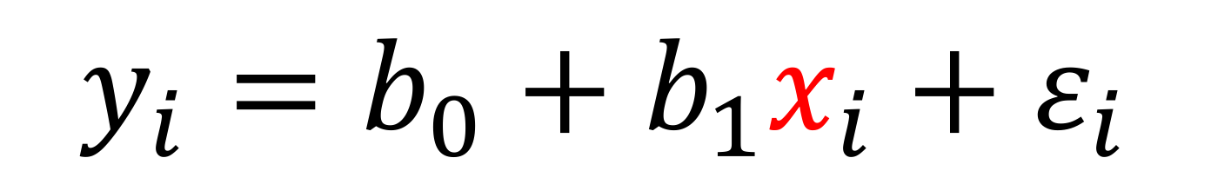
Linear models
$$y_{i}=b_{0}+b_{1}x_{i}+ε_{i}$$
y
5
3
6
10
4
i
1
2
3
4
5
x
3
1
4
8
2
i
1
2
3
4
5
Data. Response variable. Observation 1, 2, 3, etc.
e.g. sparrow body mass.
Data. Explanatory variable.
e.g. sparrow tarsus length.

Slide 14
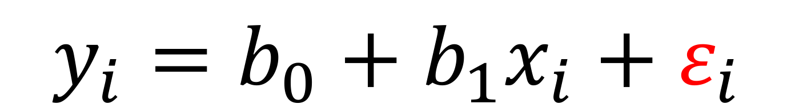
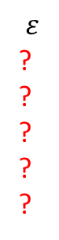
Linear models
$$y_{i}=b_{0}+b_{1}x_{i}+ε_{i}$$
$$ε$$
?
?
?
?
?
i
1
2
3
4
5

Slide 15
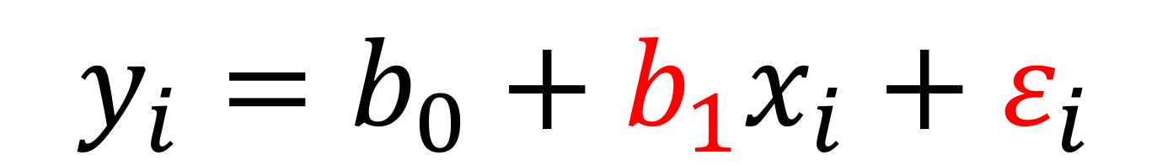
Linear models
$$y_{i}=b_{0}+b_{1}x_{i}+ε_{i}$$
$$ε$$
?
?
?
?
?
i
1
2
3
4
5
b₁ = ?

Slide 16
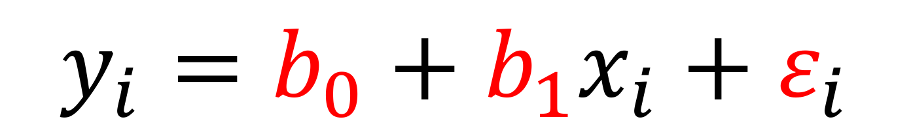
Linear models
$$y_{i}=b_{0}+b_{1}x_{i}+ε_{i}$$
$$ε$$
?
?
?
?
?
i
1
2
3
4
5
b₀ = ?
b₁ = ?

Slide 17
Linear models
Note difference in variable format
Some are vectors, others are single values!
$$y_{i}=b_{0}+b_{1}x_{i}+ε_{i}$$
y
5
3
6
10
4
i
1
2
3
4
5
x
3
1
4
8
2
i
1
2
3
4
5
$$ε$$
?
?
?
?
?
i
1
2
3
4
5
b₀ = ?
b₁ = ?

Slide 18
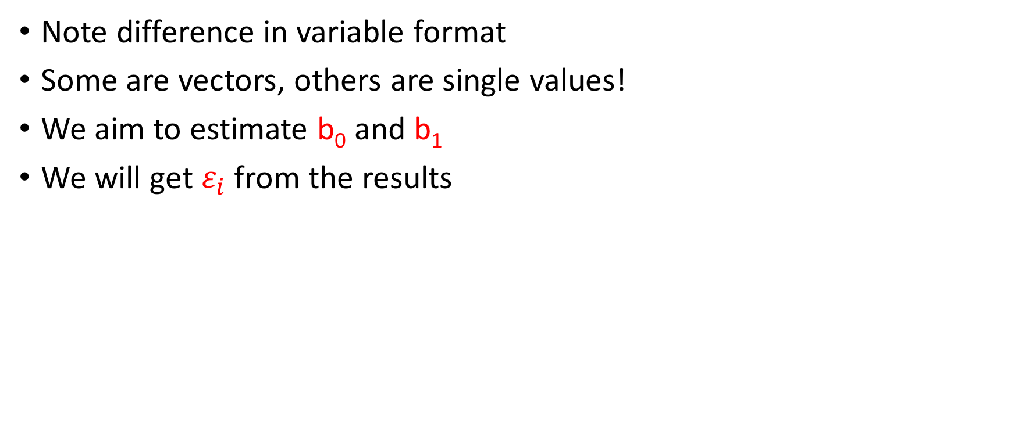
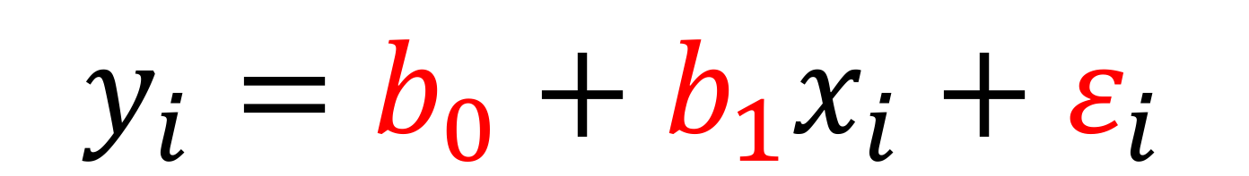
Linear models
Note difference in variable format
Some are vectors, others are single values!
We aim to estimate b₀ and b₁
We will get $ε_{i}$ from the results
$$y_{i}=b_{0}+b_{1}x_{i}+ε_{i}$$

Slide 19
Linear models
Note difference in variable format
Some are vectors, others are single values!
We aim to estimate b₀ and b₁
We will get $ε_{i}$ from the results
Parameter estimates
Error, or residuals
$$y_{i}=b_{0}+b_{1}x_{i}+ε_{i}$$

Slide 20
Let’s give this a try…
Let’s plot this
y
5
4
7
9
3
x
3
1
4
8
2
$$y_{i}=b_{0}+b_{1}x_{i}+ε_{i}$$

Slide 21
Let’s give this a try…
Let’s plot this
y
5
4
7
9
3
x
3
1
4
8
2
$$y_{i}=b_{0}+b_{1}x_{i}+ε_{i}$$

Slide 22
Let’s give this a try…
Let’s plot this
Now we “guesstimate” the line
y
5
4
7
9
3
x
3
1
4
8
2
$$y_{i}=b_{0}+b_{1}x_{i}+ε_{i}$$

Slide 23
Let’s give this a try…
Let’s plot this
Now we “guesstimate” the line
Now we “guesstimate” b₀ and b₁
y
5
4
7
9
3
x
3
1
4
8
2
$$y_{i}=b_{0}+b_{1}x_{i}+ε_{i}$$

Slide 24
Let’s give this a try…
Let’s plot this
Now we “guesstimate” the line
Now we “guesstimate” b₀ and b₁:
Intercept:
$$y_{i}=b_{0}+b_{1}x_{i}+ε_{i}$$

Slide 25
Let’s give this a try…
Let’s plot this
Now we “guesstimate” the line
Now we “guesstimate” b₀ and b₁:
Intercept: something 2.2
$$y_{i}=b_{0}+b_{1}x_{i}+ε_{i}$$

Slide 26
Let’s give this a try…
Let’s plot this
Now we “guesstimate” the line
Now we “guesstimate” b₀ and b₁:
Intercept: something 2.2
Slope: close enough to 1
$$y_{i}=b_{0}+b_{1}x_{i}+ε_{i}$$

Slide 27
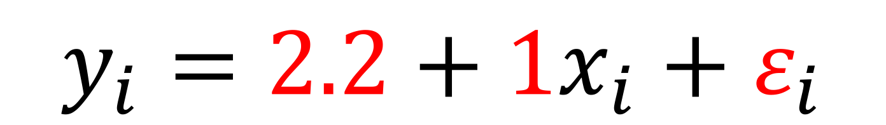
Let’s give this a try…
Let’s plot this
Now we “guesstimate” the line
Now we “guesstimate” b₀ and b₁:
Intercept: something 2.2
Slope: close enough to 1
$$y_{i}=2.2+1x_{i}+ε_{i}$$
$$y_{i}=b_{0}+b_{1}x_{i}+ε_{i}$$

Slide 28
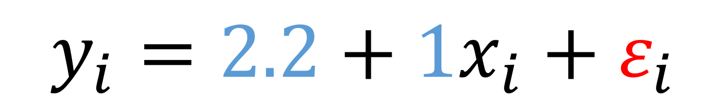
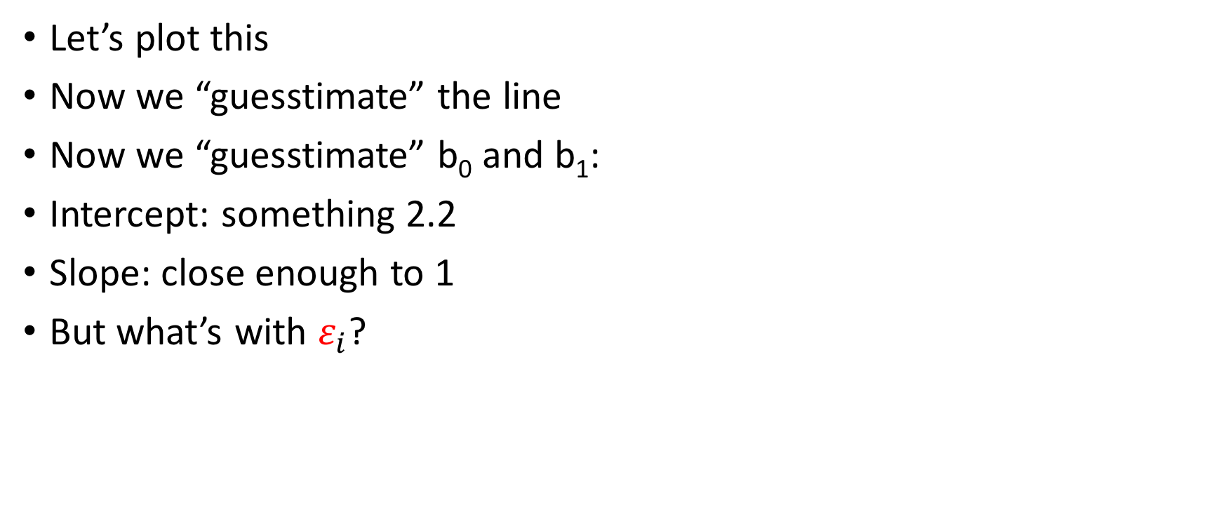
Let’s give this a try…
Let’s plot this
Now we “guesstimate” the line
Now we “guesstimate” b₀ and b₁:
Intercept: something 2.2
Slope: close enough to 1
But what’s with $ε_{i}$?
$$y_{i}=2.2+1x_{i}+ε_{i}$$

Slide 29
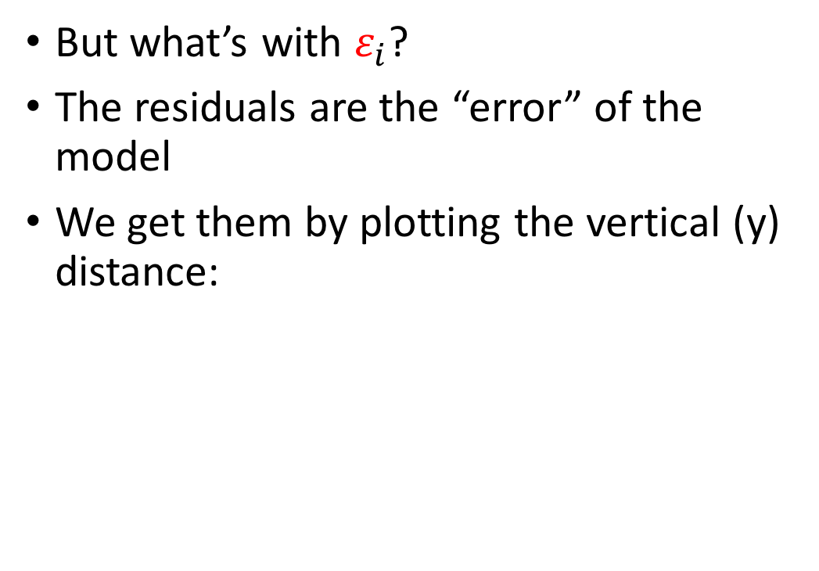
Let’s give this a try…
But what’s with $ε_{i}$?
The residuals are the “error” of the model
We get them by plotting the vertical (y) distance:
$$y_{i}=2.2+1x_{i}+ε_{i}$$

Slide 30
Let’s give this a try…
But what’s with $ε_{i}$?
The residuals are the “error” of the model
We get them by plotting the vertical (y) distance:
$$y_{i}=2.2+1x_{i}+ε_{i}$$

Slide 31
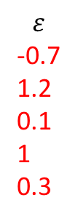

Let’s give this a try…
But what’s with $ε_{i}$?
The residuals are the “error” of the model
We get them by plotting the vertical (y) distance
$$ε$$
-0.7
1.2
0.1
1
0.3
$$y_{i}=2.2+1x_{i}+ε_{i}$$

Slide 32
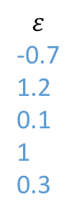
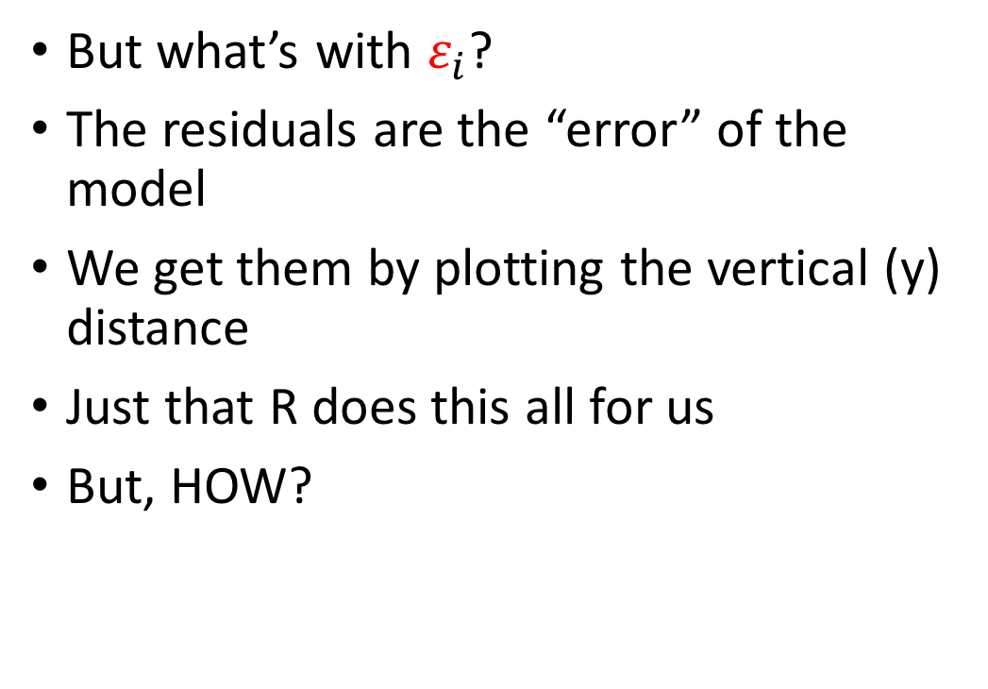
Let’s give this a try…
But what’s with $ε_{i}$?
The residuals are the “error” of the model
We get them by plotting the vertical (y) distance
Just that R does this all for us
But, HOW?
$$ε$$
-0.7
1.2
0.1
1
0.3
$$y_{i}=2.2+1x_{i}+ε_{i}$$

Slide 33
No more guesstimates…
How can we make this process scientific and mathematically tractable?

Slide 34
No more guesstimates…
How can we make this process scientific and mathematically tractable?
Idea: line with smallest residuals wins!

Slide 35
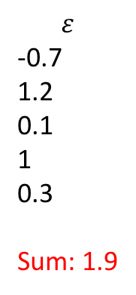
No more guesstimates…
$$ε$$
-0.7
1.2
0.1
1
0.3
Sum: 1.9

Slide 36
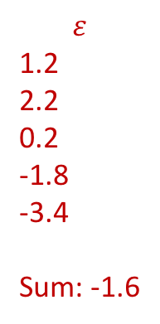
No more guesstimates…
$$ε$$
1.2
2.2
0.2
-1.8
-3.4
Sum: -1.6
$$ε$$
-0.7
1.2
0.1
1
0.3
Sum: 1.9

Slide 37
No more guesstimates…
Not a good method!

Slide 38
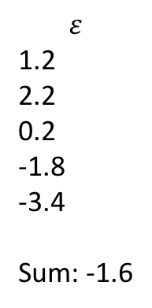
No more guesstimates…
$$ε$$
1.2
2.2
0.2
-1.8
-3.4
Sum: -1.6
$$ε$$
-0.7
1.2
0.1
1
0.3
Sum: 1.9
Need to ensure residuals are evaluated as absolute value

Slide 39
Square all of the residuals!

Slide 40
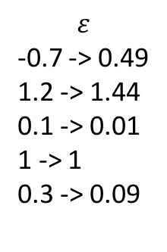
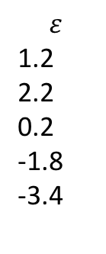
Sums of squares:
$$ε$$
1.2
2.2
0.2
-1.8
-3.4
$$ε$$
-0.7 -> 0.49
1.2 -> 1.44
0.1 -> 0.01
1 -> 1
0.3 -> 0.09

Slide 41
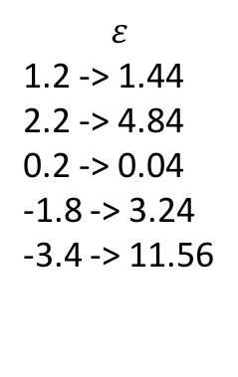
Sums of squares:
$$ε$$
1.2 -> 1.44
2.2 -> 4.84
0.2 -> 0.04
-1.8 -> 3.24
-3.4 -> 11.56
$$ε$$
-0.7 -> 0.49
1.2 -> 1.44
0.1 -> 0.01
1 -> 1
0.3 -> 0.09

Slide 42
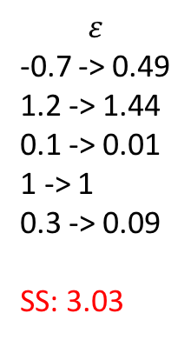
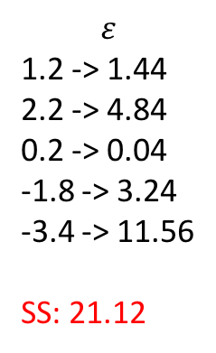
Sums of squares:
$$ε$$
1.2 -> 1.44
2.2 -> 4.84
0.2 -> 0.04
-1.8 -> 3.24
-3.4 -> 11.56
SS: 21.12
$$ε$$
-0.7 -> 0.49
1.2 -> 1.44
0.1 -> 0.01
1 -> 1
0.3 -> 0.09
SS: 3.03

Slide 43

Use Sums of Squares to assess goodness of fit
Find b₀ and b₁ of a line that is positioned so that it minimizes the sum of the squared residuals $ε_{i}$ for the data y_{i} and x_{i}

Slide 44
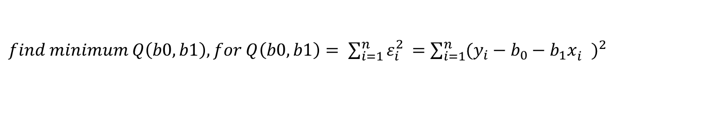
Use Sums of Squares to assess goodness of fit
Find b₀ and b₁ of a line that is positioned so that it minimizes the sum of the squared residuals $ε_{i}$ for the data y_{i} and x_{i}
$find minimum Q\left(b0,b1\right), for Q\left(b0,b1\right)= \sum_{i=1}^{n}{ε_{i}^{2 }=\sum_{i=1}^{n}{{{(y_{i}−b_{0}−b_{1}x}_{i}^{})}^{2}}}$
Solve for b₁, and b₀

Slide 45
Use Sums of Squares to assess goodness of fit
Find b₀ and b₁ of a line that is positioned so that it minimizes the sum of the squared residuals $ε_{i}$ for the data y_{i} and x_{i}
$find minimum Q\left(b0,b1\right), for Q\left(b0,b1\right)= \sum_{i=1}^{n}{ε_{i}^{2 }=\sum_{i=1}^{n}{{{(y_{i}−b_{0}−b_{1}x}_{i}^{})}^{2}}}$
Solve for b₁, and b₀

Slide 46
Use Sums of Squares to assess goodness of fit
Find b₀ and b₁ of a line that is positioned so that it minimizes the sum of the squared residuals $ε_{i}$ for the data y_{i} and x_{i}
$find minimum Q\left(b0,b1\right), for Q\left(b0,b1\right)= \sum_{i=1}^{n}{ε_{i}^{2 }=\sum_{i=1}^{n}{{{(y_{i}−b_{0}−b_{1}x}_{i}^{})}^{2}}}$
ALGEBRA
Solve for b₁, and b₀

Slide 47
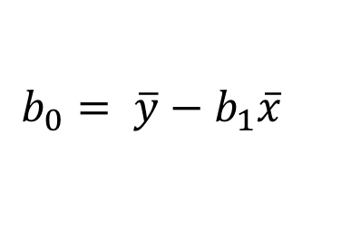
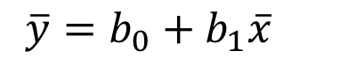
Use Sums of Squares to assess goodness of fit
Find b₀ and b₁ of a line that is positioned so that it minimizes the sum of the squared residuals $ε_{i}$ for the data y_{i} and x_{i}
$find minimum Q\left(b0,b1\right), for Q\left(b0,b1\right)= \sum_{i=1}^{n}{ε_{i}^{2 }=\sum_{i=1}^{n}{{{(y_{i}−b_{0}−b_{1}x}_{i}^{})}^{2}}}$
ALGEBRA
Solve for b₁, and b₀
$$\overline{y}=b_{0}+b_{1}\overline{x}$$
$$b_{0}= \overline{y}−b_{1}\overline{x}$$

Slide 48
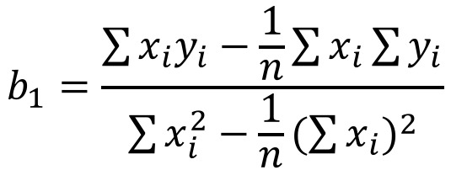
Use Sums of Squares to assess goodness of fit
Find b₀ and b₁ of a line that is positioned so that it minimizes the sum of the squared residuals $ε_{i}$ for the data y_{i} and x_{i}
$find minimum Q\left(b0,b1\right), for Q\left(b0,b1\right)= \sum_{i=1}^{n}{ε_{i}^{2 }=\sum_{i=1}^{n}{{{(y_{i}−b_{0}−b_{1}x}_{i}^{})}^{2}}}$
ALGEBRA
Solve for b₁, and b₀
$$b_{1}=\frac{\sum{x_{i}y_{i}−\frac{1}{n}\sum{x_{i}\sum{y_{i}}}}}{\sum{x_{i}^{2}−\frac{1}{n}{(\sum{x_{i}})}^{2}}}$$
$$b_{0}= \overline{y}−b_{1}\overline{x}$$

Slide 49
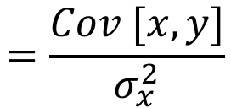
Use Sums of Squares to assess goodness of fit
Find b₀ and b₁ of a line that is positioned so that it minimizes the sum of the squared residuals $ε_{i}$ for the data y_{i} and x_{i}
$find minimum Q\left(b0,b1\right), for Q\left(b0,b1\right)= \sum_{i=1}^{n}{ε_{i}^{2 }=\sum_{i=1}^{n}{{{(y_{i}−b_{0}−b_{1}x}_{i}^{})}^{2}}}$
ALGEBRA
Solve for b₁, and b₀
$$b_{1}=\frac{\sum{x_{i}y_{i}−\frac{1}{n}\sum{x_{i}\sum{y_{i}}}}}{\sum{x_{i}^{2}−\frac{1}{n}{(\sum{x_{i}})}^{2}}}$$
$$=\frac{Cov [x,y]}{σ_{x}^{2}}$$
$$b_{0}= \overline{y}−b_{1}\overline{x}$$

Slide 50
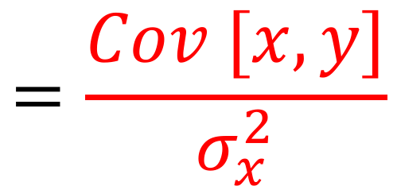
Use Sums of Squares to assess goodness of fit
Find b₀ and b₁ of a line that is positioned so that it minimizes the sum of the squared residuals $ε_{i}$ for the data y_{i} and x_{i}
$find minimum Q\left(b0,b1\right), for Q\left(b0,b1\right)= \sum_{i=1}^{n}{ε_{i}^{2 }=\sum_{i=1}^{n}{{{(y_{i}−b_{0}−b_{1}x}_{i}^{})}^{2}}}$
ALGEBRA
Solve for b₁, and b₀
Covariance between x and y
$$b_{1}=\frac{\sum{x_{i}y_{i}−\frac{1}{n}\sum{x_{i}\sum{y_{i}}}}}{\sum{x_{i}^{2}−\frac{1}{n}{(\sum{x_{i}})}^{2}}}$$
$$=\frac{Cov [x,y]}{σ_{x}^{2}}$$
$$b_{0}= \overline{y}−b_{1}\overline{x}$$

Slide 51
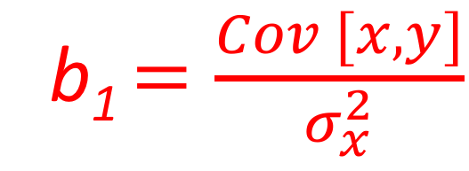
Use Sums of Squares to assess goodness of fit
Find b₀ and b₁ of a line that is positioned so that it minimizes the sum of the squared residuals $ε_{i}$ for the data y_{i} and x_{i}
$find minimum Q\left(b0,b1\right), for Q\left(b0,b1\right)= \sum_{i=1}^{n}{ε_{i}^{2 }=\sum_{i=1}^{n}{{{(y_{i}−b_{0}−b_{1}x}_{i}^{})}^{2}}}$
ALGEBRA
Solve for b₁, and b₀
Covariance between x and y
$$b_{1}=\frac{\sum{x_{i}y_{i}−\frac{1}{n}\sum{x_{i}\sum{y_{i}}}}}{\sum{x_{i}^{2}−\frac{1}{n}{(\sum{x_{i}})}^{2}}}$$
b₁ $=\frac{Cov [x,y]}{σ_{x}^{2}}$
$$b_{0}= \overline{y}−b_{1}\overline{x}$$
Variance of x

Slide 52
Let’s give this a try…
Let’s plot this
Now we “guesstimate” the line
Now we “guesstimate” b₀ and b₁:
Intercept: something 2.2
Slope: close enough to 1
But what’s with $ε_{i}$?
$$y_{i}=2.2+1x_{i}+ε_{i}$$

Slide 53
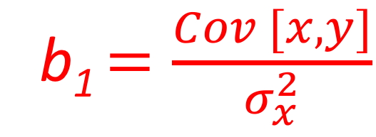
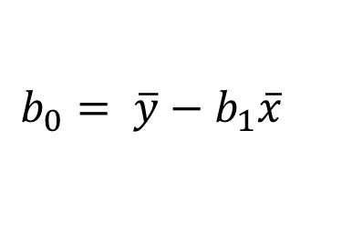
Let’s give this a try:
$$ε$$
-0.7 -> 0.49
1.2 -> 1.44
0.1 -> 0.01
1 -> 1
0.3 -> 0.09
SS: 3.03
$$b_{0}= \overline{y}−b_{1}\overline{x}$$
b₁ $=\frac{Cov [x,y]}{σ_{x}^{2}}$
$$y_{i}=2.2+1x_{i}+ε_{i}$$
SS: 3.03

Slide 54
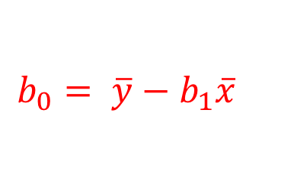
Let’s give this a try:
x, y
1,4
2,3
3.5
4,7
8,9
$$b_{0}= \overline{y}−b_{1}\overline{x}$$
b₁ $=\frac{Cov [x,y]}{σ_{x}^{2}}$
$$y_{i}=2.2+1x_{i}+ε_{i}$$
SS: 3.03

Slide 55
Let’s give this a try:
x, y
1,4
2,3
3.5
4,7
8,9
$$b_{0}= \overline{y}−b_{1}\overline{x}$$
b₁ $=\frac{Cov [x,y]}{σ_{x}^{2}}$
$$y_{i}=2.2+1x_{i}+ε_{i}$$
SS: 3.03

Slide 56
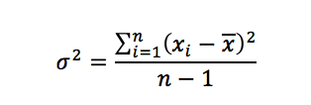
VARIANCE
x
Y_{i}

Slide 57
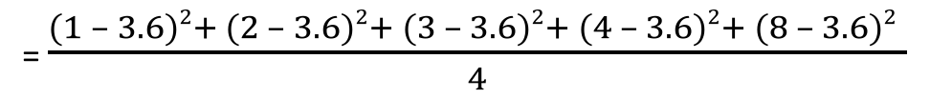
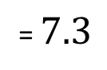
Let’s give this a try:
x, y
1,4
2,3
3.5
4,7
8,9
= $\frac{(1 – 3.6)2+ (2 – 3.6)2+ (3 – 3.6)2+ (4 – 3.6)2+ (8 – 3.6)2 }{4}$
= $7.3$
$$b_{0}= \overline{y}−b_{1}\overline{x}$$
b₁ $=\frac{Cov [x,y]}{σ_{x}^{2}}$
$$y_{i}=2.2+1x_{i}+ε_{i}$$
SS: 3.03

Slide 58
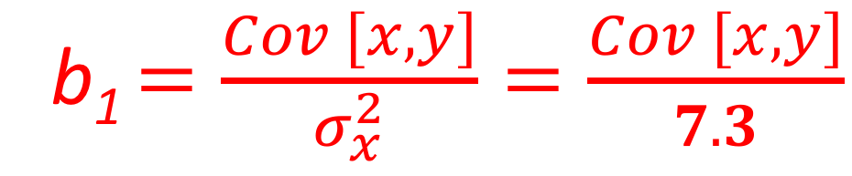
Let’s give this a try:
x, y
1,4
2,3
3.5
4,7
8,9
= $\frac{(1 – 3.6)2+ (2 – 3.6)2+ (3 – 3.6)2+ (4 – 3.6)2+ (8 – 3.6)2 }{4}$
= $7.3$
$$b_{0}= \overline{y}−b_{1}\overline{x}$$
b₁ $=\frac{Cov [x,y]}{σ_{x}^{2}}=\frac{Cov [x,y]}{7.3}$
$$y_{i}=2.2+1x_{i}+ε_{i}$$
SS: 3.03

Slide 59
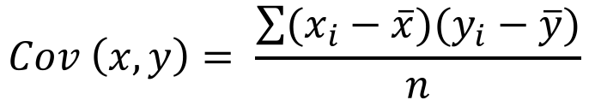
Let’s give this a try:
x, y
1,4
2,3
3.5
4,7
8,9
$$Cov \left(x,y\right)= \frac{\sum{(x_{i}−\overline{x})(y_{i}−\overline{y})}}{n}$$
$$b_{0}= \overline{y}−b_{1}\overline{x}$$
b₁ $=\frac{Cov [x,y]}{σ_{x}^{2}}=\frac{Cov [x,y]}{7.3}$
$$y_{i}=2.2+1x_{i}+ε_{i}$$
SS: 3.03

Slide 60
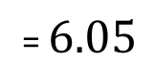
Let’s give this a try:
x, y
1,4
2,3
3.5
4,7
8,9
$$Cov \left(x,y\right)= \frac{\sum{(x_{i}−\overline{x})(y_{i}−\overline{y})}}{n}$$
= $6.05$
$$b_{0}= \overline{y}−b_{1}\overline{x}$$
b₁ $=\frac{Cov [x,y]}{σ_{x}^{2}}=\frac{Cov [x,y]}{7.3}$
$$y_{i}=2.2+1x_{i}+ε_{i}$$
SS: 3.03

Slide 61
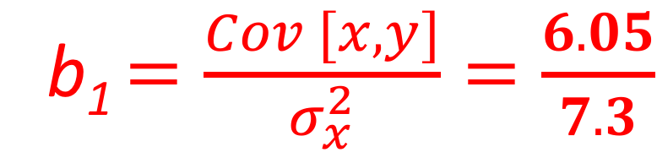
Let’s give this a try:
x, y
1,4
2,3
3.5
4,7
8,9
$$Cov \left(x,y\right)= \frac{\sum{(x_{i}−\overline{x})(y_{i}−\overline{y})}}{n}$$
= $6.05$
$$b_{0}= \overline{y}−b_{1}\overline{x}$$
b₁ $=\frac{Cov [x,y]}{σ_{x}^{2}}=\frac{6.05}{7.3}$
$$y_{i}=2.2+1x_{i}+ε_{i}$$
SS: 3.03

Slide 62
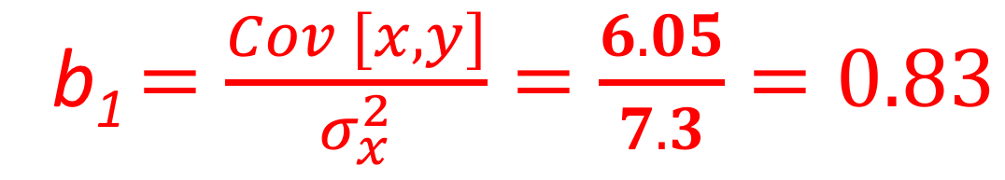
Let’s give this a try:
x, y
1,4
2,3
3.5
4,7
8,9
$$Cov \left(x,y\right)= \frac{\sum{(x_{i}−\overline{x})(y_{i}−\overline{y})}}{n}$$
= $6.05$
$$b_{0}= \overline{y}−b_{1}\overline{x}$$
b₁ $=\frac{Cov [x,y]}{σ_{x}^{2}}=\frac{6.05}{7.3}=0.83$
$$y_{i}=2.2+1x_{i}+ε_{i}$$
SS: 3.03

Slide 63
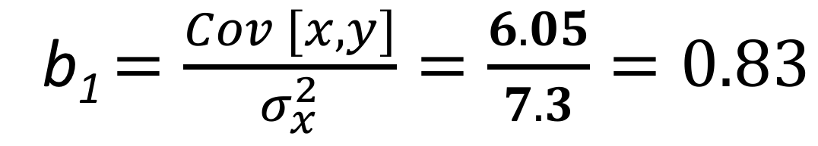

Let’s give this a try:
x, y
1,4
2,3
3.5
4,7
8,9
$$Cov \left(x,y\right)= \frac{\sum{(x_{i}−\overline{x})(y_{i}−\overline{y})}}{n}$$
= $6.05$
$$b_{0}= \overline{y}−b_{1}\overline{x}$$
b₁ $=\frac{Cov [x,y]}{σ_{x}^{2}}=\frac{6.05}{7.3}=0.83$
$$y_{i}=2.2+0.83x_{i}+ε_{i}$$
SS: 3.03

Slide 64
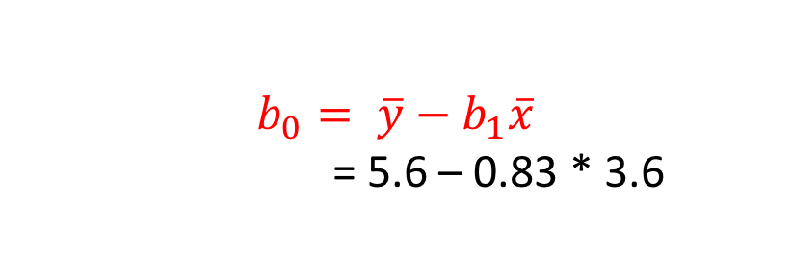
Let’s give this a try:
x, y
1,4
2,3
3.5
4,7
8,9
$$Cov \left(x,y\right)= \frac{\sum{(x_{i}−\overline{x})(y_{i}−\overline{y})}}{n}$$
= $6.05$
$$b_{0}= \overline{y}−b_{1}\overline{x}$$
= 5.6 – 0.83 * 3.6
b₁ $=\frac{Cov [x,y]}{σ_{x}^{2}}=\frac{6.05}{7.3}=0.83$
$$y_{i}=2.2+0.83x_{i}+ε_{i}$$
SS: 3.03

Slide 65
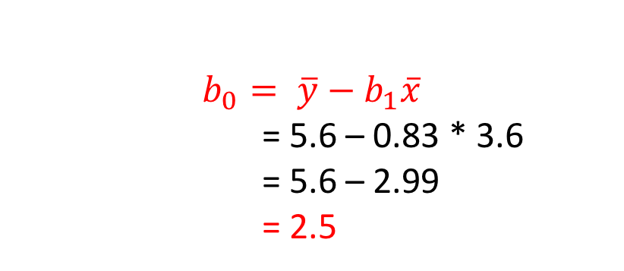
Let’s give this a try:
x, y
1,4
2,3
3.5
4,7
8,9
$$Cov \left(x,y\right)= \frac{\sum{(x_{i}−\overline{x})(y_{i}−\overline{y})}}{n}$$
= $6.05$
$$b_{0}= \overline{y}−b_{1}\overline{x}$$
= 5.6 – 0.83 * 3.6
= 5.6 – 2.99
= 2.5
b₁ $=\frac{Cov [x,y]}{σ_{x}^{2}}=\frac{6.05}{7.3}=0.83$
$$y_{i}=2.2+0.83x_{i}+ε_{i}$$
SS: 3.03

Slide 66
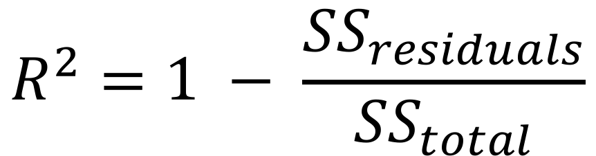
R²
Coefficient of determination
Proportion of how much variance in y is explained by x
$$R^{2}=1 − \frac{{SS}_{residuals}}{{SS}_{total}}$$

Slide 67
R²
Coefficient of determination
Proportion of how much variance in y is explained by x
$$R^{2}=1 − \frac{{SS}_{residuals}}{{SS}_{total}}$$
Wait, what?

Slide 68
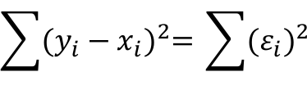
R²
Coefficient of determination
Proportion of how much variance in y is explained by x
$$R^{2}=1 − \frac{{SS}_{residuals}}{{SS}_{total}}$$
We know what SS_{res} is – the residual sum of squares.
$$\sum{{(y_{i}−x_{i})}^{2}= }\sum{{(ε_{i})}^{2} }$$

Slide 69
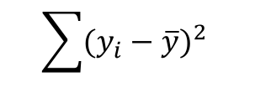
R²
Coefficient of determination
Proportion of how much variance in y is explained by x
$$R^{2}=1 − \frac{{SS}_{residuals}}{{SS}_{total}}$$
We know what SS_{res} is – the residual sum of squares
The total sum of squares is this:
$$\sum{{(y_{i}−x_{i})}^{2}= }\sum{{(ε_{i})}^{2} }$$
$$\sum{{(y_{i}−\overline{y})}^{2} }$$

Slide 70
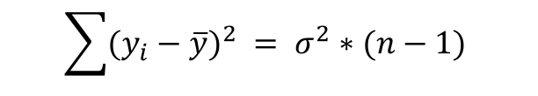
R²
Coefficient of determination
Proportion of how much variance in y is explained by x
$$R^{2}=1 − \frac{{SS}_{residuals}}{{SS}_{total}}$$
We know what SS_{res} is – the residual sum of squares
The total sum of squares is this:
$$\sum{{(y_{i}−x_{i})}^{2}= }\sum{{(ε_{i})}^{2} }$$
$$\sum{{(y_{i}−\overline{y})}^{2} }= σ^{2}∗(n−1)$$

Slide 71
R²
Coefficient of determination
Proportion of how much variance in y is explained by x
x, y
1,4
2,3
3.5
4,7
8,9
$$R^{2}=1 − \frac{{SS}_{residuals}}{{SS}_{total}}$$
We know what SS_{res} is – the residual sum of squares
The total sum of squares is this:
$$\sum{{(y_{i}−x_{i})}^{2}= }\sum{{(ε_{i})}^{2} }$$
3.03
$$\sum{{(y_{i}−\overline{y})}^{2} }= σ^{2}∗(n−1)$$
5.8 * 4
23.2

Slide 72

R²
Coefficient of determination
Proportion of how much variance in y is explained by x
x, y
1,4
2,3
3.5
4,7
8,9
$$R^{2}=1 − \frac{{SS}_{residuals}}{{SS}_{total}}$$
= 1 – 3.03/23.2
= 0.87
We know what SS_{res} is – the residual sum of squares
The total sum of squares is the nominator of $σ^{2}$:
$$\sum{{(y_{i}−x_{i})}^{2}= }\sum{{(ε_{i})}^{2} }$$
3.03
$$\sum{{(y_{i}−\overline{y})}^{2} }= σ^{2}∗(n−1)$$
5.8 * 4
23.2

Slide 73
Linear regression:
Minimizing sum of squared residuals of line
Then get b₁ and b₀
Calculate R² to assess how much variance in the response variable is explained by the explanatory variable

Slide 74


Exercise – no hand-out
$$ε$$
-0.7
1.2
0.1
1
0.
SS: 3.03
$$y_{i}=2.2+0.83x_{i}+ε_{i}$$
R² = 0.87
Run a linear regression in R with x and y as we’ve used them here.
x<-c(1,2,3,4,8)
y<c(4,3,5,7,9)
model1 <- (lm(y~x))
model1
summary(model1)
anova(model1)
resid(model1)
cov(x,y)
var(x)
plot(y~x)
x, y
1,4
2,3
3.5
4,7
8,9

